Slide 1

UE20CS390B – Capstone Project Phase – 2
Project Progress Review # 1
Project Title : Multispectral Image Dehazing
Project ID : PW23_SSS_01
Project Guide : Dr. Shylaja SS
Project Team : Keerthana Shivakumar (PES1UG20CS204)
Aaditya Vikram(PES1UG20CS528)
Abhilash CS (PES1UG20CS530)
Chaithra (PES1UG20CS543)

Slide 2
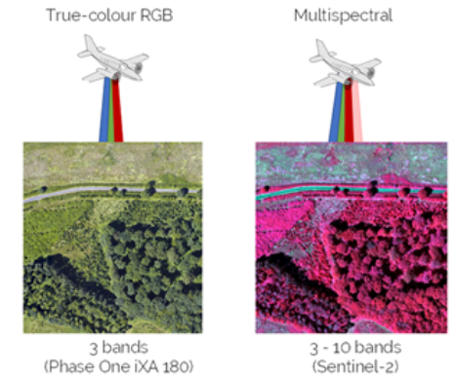
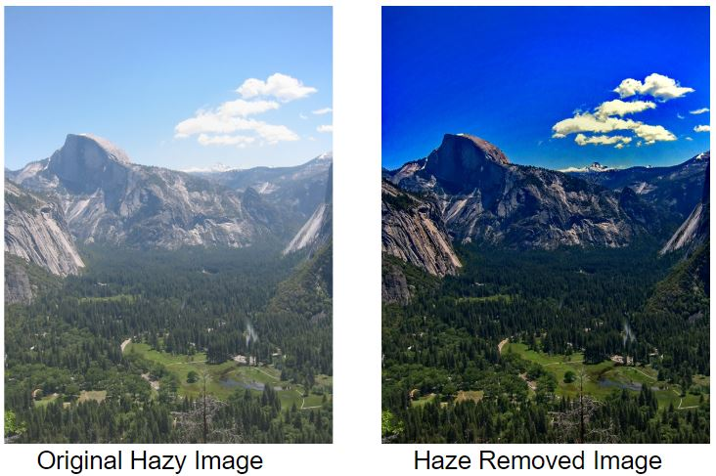
Multispectral Image Dehazing
Introduction
Multispectral images capture data across various electromagnetic spectrum bands, including infrared and ultraviolet, beyond the visible spectrum.
Image dehazing is the process of enhancing the visibility and clarity of a hazy or foggy image, improving its visual quality.

Slide 3
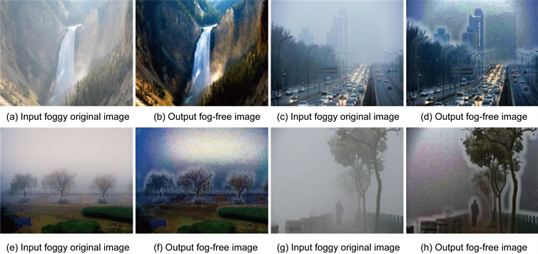
Multispectral Image Dehazing
Why existing techniques can’t be applied?
Dark channel prior identifies the minimum intensity value within local image patches.
Doesn’t give effective results when there is sky in the image
Adds unnecessary artifacts to image
Notes:
Explain something about dark channel prior and why it fails when there is sky in image or it gives unnecessary artifacts to image.

Slide 4

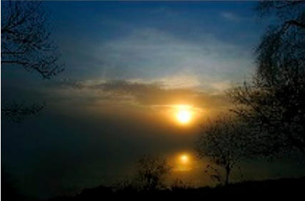

Multispectral Image Dehazing
Why existing techniques can’t be applied?
Color attenuation prior calculates how much color information is affected by haze, helping to improve image clarity.
Struggles to handle scenes where the color of objects is similar to that of the haze.
HAZY IMAGE
PREDICTED OUTPUT
GROUND TRUTH
Notes:
Explain very short about color attenuation prior and just say why it does not work?

Slide 5
So with every model giving estimation of transmission map it always neglects certain conditions giving wrong results…..
SOLUTION : USE NEURAL NETWORKS !!!

Slide 6
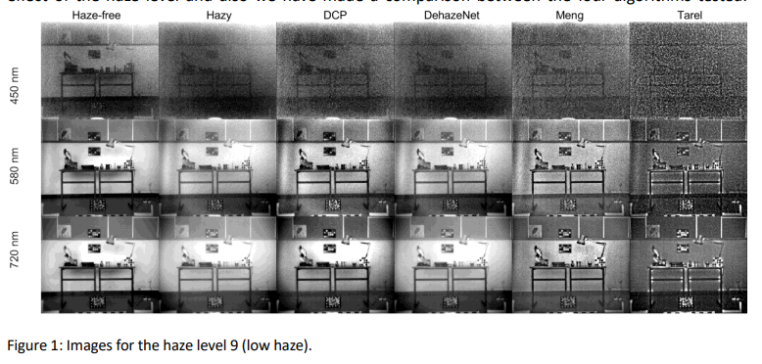
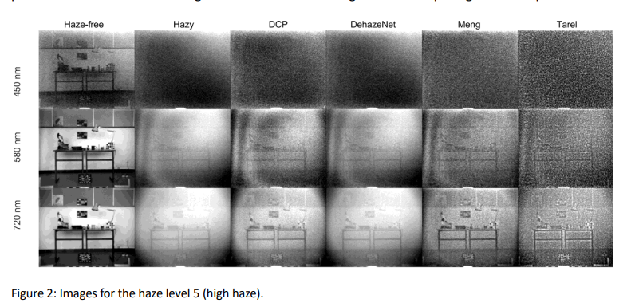
Multispectral Image Dehazing
Why can’t image dehazing models be used for multispectral dehazing ?
Not considering how different colors of light are affected differently by haze can lead to inaccurate dehazing results, as it overlooks the impact of wavelength variations.
When popular dehazing models were applied to the SHIA dataset, it became evident that ignoring this wavelength dependency could produce incorrect outcomes in hazy image restoration.
Notes:
Architecture
Explain the model we went through - Spidenet (include diagram)
Dataset
Put multispectral images

Slide 7
Multispectral Image Dehazing
Why can’t image dehazing models be used for multispectral dehazing ?
Notes:
Architecture
Explain the model we went through - Spidenet (include diagram)
Dataset
Put multispectral images

Slide 8
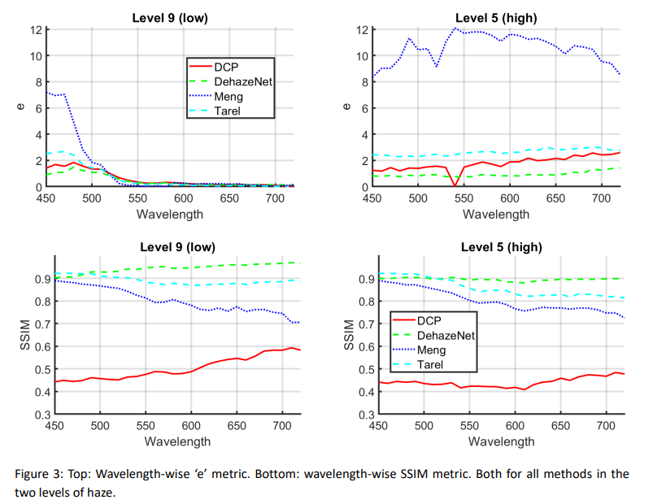
Multispectral Image Dehazing
Why can’t image dehazing models be used for multispectral dehazing ?
Notes:
Clearly we can see that with increasing wavelength the clarity of the image is
also improving. So clearly there is a wavelength dependence and we need to consider this while dehazing

Slide 9
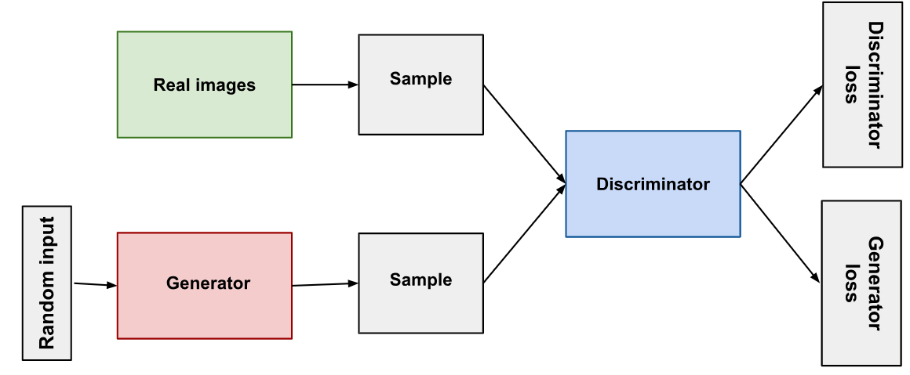
Multispectral Image Dehazing
Introduction to GAN
About GAN
Train 2 networks - Generator and Discriminator in Adversarial settings
Generator - Produce realistic looking samples
Discriminator - Figure out if the image is from training set or generator network
Generator fools discriminator network

Slide 10
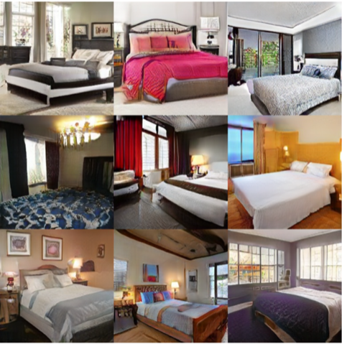
Multispectral Image Dehazing
Introduction to GAN
Applications of GAN
Image Generation (photo-realistic, hazed to dehazed images)
Style transfer (Photographs to paintings)
Challenges of GAN
Tricky to train
Limited diversity of output
Sensitive to hyperparameters

Slide 11
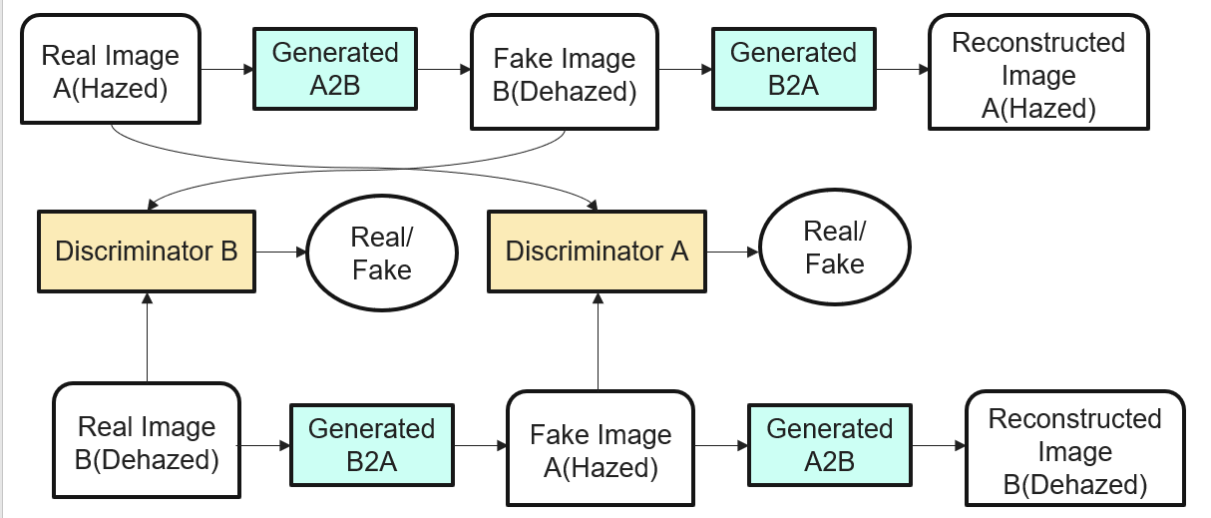
Multispectral Image Dehazing
CycleGAN
What is CycleGAN?
Transfer characteristics of one image to another or map the distribution of images to another
Notes:
Advantage - Image translation on an unpaired image can be done even when there is no relationship between input and output image.
explain why we want to use cycleGAN for dehazing
can enhance cycleGAN using ScopeGAN

Slide 12
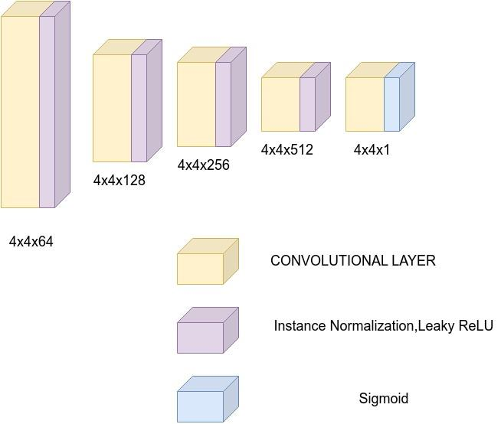
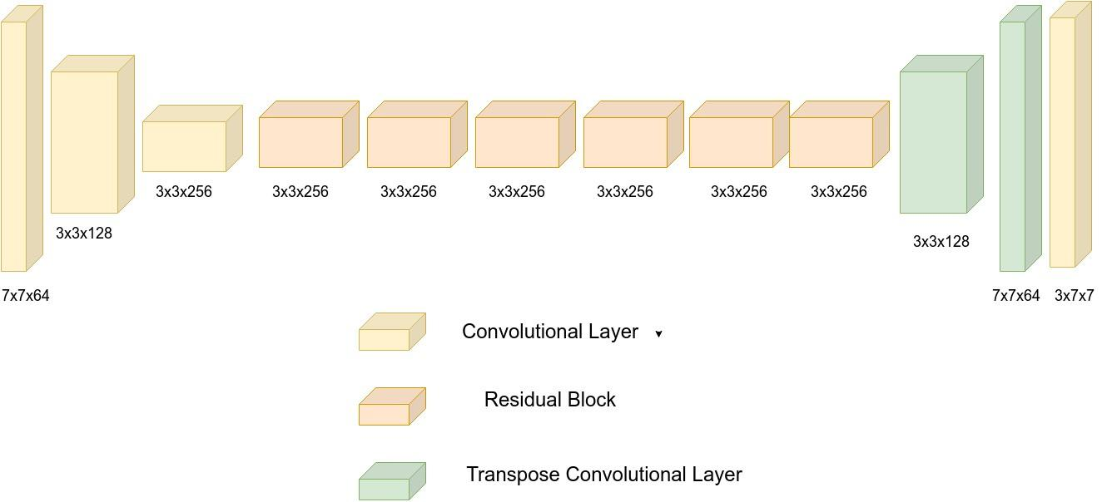
Multispectral Image Dehazing
Architecture
Discriminator Architecture
Generator Architecture
Notes:
Better to explain how the architecture has been implemented via code.

Slide 13
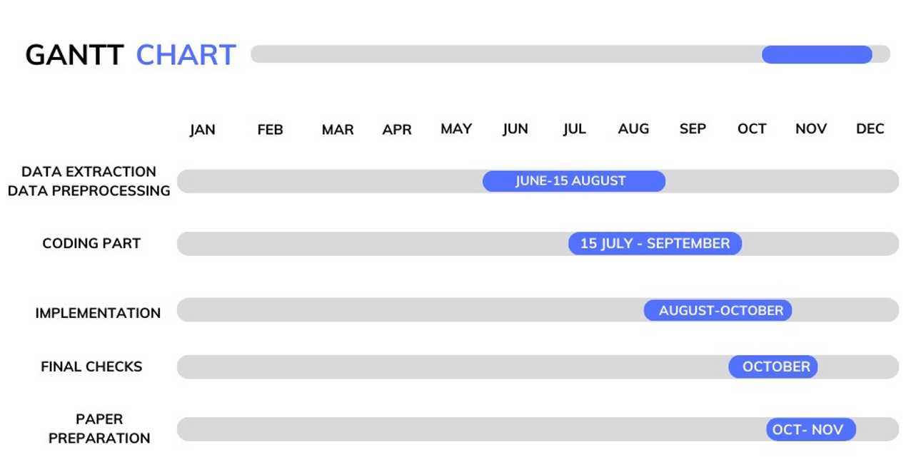
Multispectral Image Dehazing

Slide 14
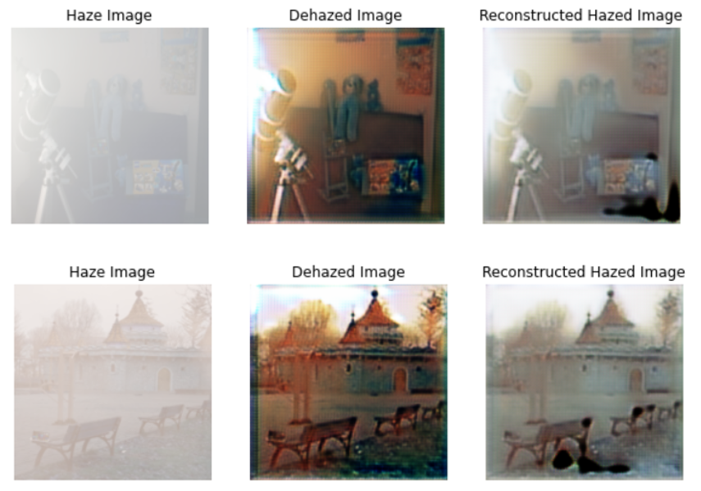
Multispectral Image Dehazing
Results of CycleGAN
PSNR - 49.252
SSIM - 0.888
PSNR - 48.921
SSIM - 0.881

Slide 15
Multispectral Image Dehazing
References
https://github.com/FusionAI/Image-Dehazing-using-CycleGAN
J. -Y. Zhu, T. Park, P. Isola and A. A. Efros, "Unpaired Image-to-Image Translation Using Cycle-Consistent Adversarial Networks," 2017 IEEE International Conference on Computer Vision (ICCV), Venice, Italy, 2017, pp. 2242-2251, doi: 10.1109/ICCV.2017.244.
https://drive.google.com/drive/folders/1ytLc1atUNpvauXHHXCQrN9vpw_dsGSow?usp=sharing

Slide 16
Thank You

